Slide 1
OBJECT ORIENTED PROGRAMMING
(ICT 2155)

Slide 2
Collections Framework.
Hierarchy of interfaces and classes that provide state-of-the-art technology for managing groups of objects.
Present in java.util package.

Slide 3
Collections Overview
Collections Framework standardizes the way in which groups of objects are handled in our programs.
Collections were not part of the original Java release, but were added by J2SE 1.2.
Prior to the Collections Framework:
  Java provided ad hoc classes such as Dictionary, Vector, Stack, and Properties to store and manipulate groups of objects.
  Although these classes were quite useful, they lacked a central, unifying theme.

Slide 4
Collections Overview
The entire Collections Framework is built upon a set of standard interfaces.
Each interface type is implemented by one or more classes
Each class is designed for a specific type of storage.

Slide 5
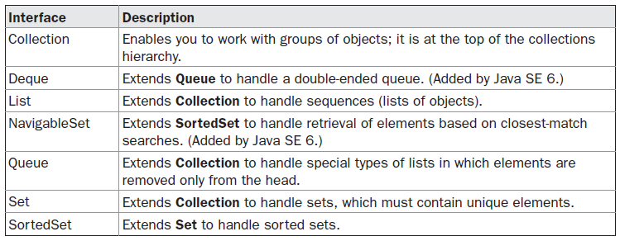
The Collection Interfaces
The Collections Framework defines several interfaces.
The concrete classes simply provide different implementations of the standard interfaces.

Slide 6
Collection
List
Set
Queue
ArrayList
LinkedList
Vector
HashSet
SortedSet
Deque
NavigableSet
TreeSet

Slide 7
Map
HashMap
TreeMap

Slide 8
The Collection Interface
The Collection interface is the foundation upon which the Collections Framework is built.
It must be implemented by any class that defines a collection.
Collection is a generic interface that has this declaration:
interface Collection<E>
Here, E specifies the type of objects that the collection will hold.
Collection extends the Iterable interface.
all collections can be cycled through by use of the for-each style for loop.

Slide 9
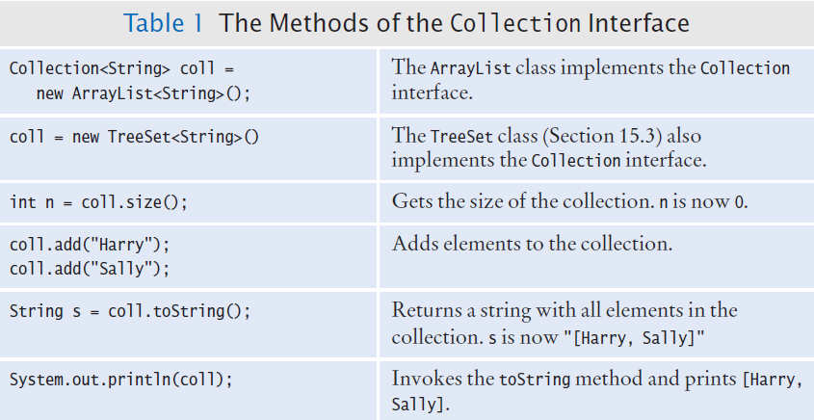
The Collection Interface
List, Queue and Set are specialized interfaces that inherit from the Collection interface. All share the following commonly used methods

Slide 10
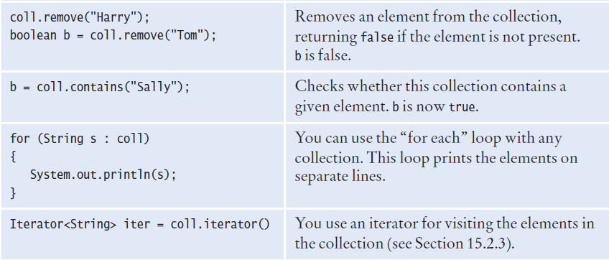

Slide 11
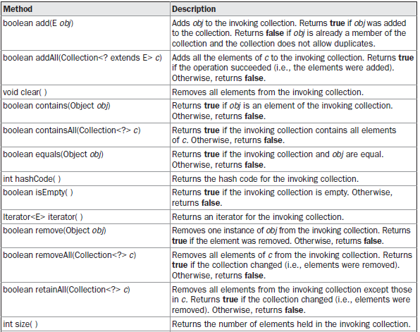
Collection declares the core methods that all collections will have.

Slide 12
The List Interface
The List interface extends Collection and declares the behavior of a collection that stores a sequence of elements.
Elements can be inserted or accessed by their position in the list, using
a zero-based index.
A list may contain duplicate elements.
List is a generic interface that has this declaration:
interface List<E>
Here, E specifies the type of objects that the list will hold.

Slide 13
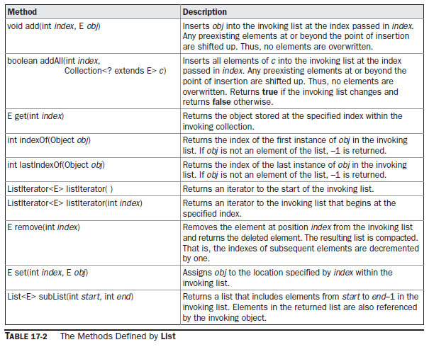
In addition to the methods defined by Collection, List defines some of its own,

Slide 14

List
Ordered Lists
  ArrayList
    Stores a list of items in a dynamically sized array
  LinkedList
    Allows speedy insertion and removal of items from the list
A list is a collection that maintains the order of its elements.

Slide 15

Set
Unordered Sets
  HashSet
    Uses hash tables to speed up finding, adding, and removing elements
  TreeSet
    Uses a binary tree to speed up finding, adding, and removing elements

Slide 16
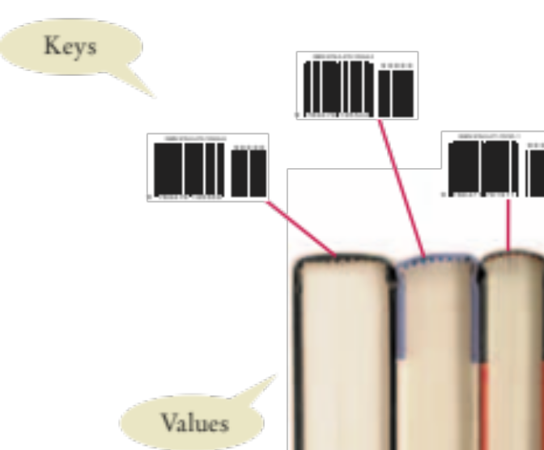
Maps
A map stores keys, values, and the associations between them
  Example:
  Barcode keys and books
Keys
  Provides an easy way to represent an object (such as a numeric bar code)
Values
  The actual object that is associated with the key
A map keeps associations
between key and value objects.

Slide 17
Array List
ArrayList is a part of collection framework.
Present in java.util package.
Java ArrayList class uses a dynamic array for storing the elements.
It inherits AbstractList class and implements List interface.

Slide 18
https://www.javatpoint.com/java-arraylist
import java.util.*;
public class ArrayListExample4{
public static void main(String args[]){
ArrayList<String> al=new ArrayList<String>();
al.add("Mango");
al.add("Apple");
al.add("Banana");
al.add("Grapes");
//accessing the element
System.out.println("Returning element: "+al.get(1));//it will return the 2nd element, because index starts from 0
//changing the element
al.set(1,"Dates");
//Traversing list
for(String fruit:al)
System.out.println(fruit);
}
}

Slide 19
import java.util.*;
class ArrayList4{
public static void main(String args[]){
ArrayList<String> list=new ArrayList<String>();//Creating arraylist
list.add("Ravi");//Adding object in arraylist
list.add("Vijay");
list.add("Ravi");
list.add("Ajay");
System.out.println("Traversing list through List Iterator:");
//Here, element iterates in reverse order
ListIterator<String> list1=list.listIterator(list.size());
while(list1.hasPrevious())
{
String str=list1.previous();
System.out.println(str);
}
System.out.println("Traversing list through for loop:");
for(int i=0;i<list.size();i++)
{
System.out.println(list.get(i));
}
System.out.println("Traversing list through forEach() method:");
//The forEach() method is a new feature, introduced in Java 8.
list.forEach(a->{ //Here, we are using lambda expression
System.out.println(a);
});
System.out.println("Traversing list through forEachRemaining() method:");
Iterator<String> itr=list.iterator();
itr.forEachRemaining(a-> //Here, we are using lambda expression
{
System.out.println(a);
});
}
}

Slide 20
Array List
ArrayList slower than standard arrays but can be helpful in programs where lots of manipulation in the array is needed.
ArrayList is initialized by a size, however the size can increase if collection grows or shrunk if objects are removed from the collection.
Java ArrayList allows us to randomly access the list.
ArrayList can not be used for primitive types, like int, char, etc. We need a wrapper class for such cases.

Slide 21
The important points about Java ArrayList class are:
ArrayList class can contain duplicate elements.
ArrayList class maintains insertion order.
ArrayList class is non synchronized.
In ArrayList class, manipulation is slow because a lot of shifting needs to be occurred if any element is removed from the array list.

Slide 22
ArrayList<type> arr = new ArrayList<type>();
ArrayList<Integer> arr = new ArrayList<Integer>();
ArrayList<String> arr = new ArrayList<String>();
ArrayList<Employee> arr = new ArrayList<Employee>();

Slide 23
int n = 5; // size of ArrayList
ArrayList<Integer> arrli = new ArrayList<Integer>(n);
// Appending the new element at the end of the list
for (int i=1; i<=n; i++)
arrli.add(i);
for (int i=0; i<arrli.size(); i++)
System.out.print(arrli.get(i)+" ");
OUTPUT : 1 2 3 4 5

Slide 24
int n = 5; // size of ArrayList
ArrayList<Integer> arrli = new ArrayList<Integer>(n);
// Appending the new element at the end of the list
for (int i=1; i<=n; i++)
arrli.add(i);
System.out.println(arrli);
OUTPUT : [1 2 3 4 5]

Slide 25
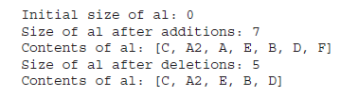
ArrayList al = new ArrayList();
System.out.println("Initial size of al: " + al.size());
al.add("C");
al.add("A");
al.add("E");
al.add("B");
al.add("D");
al.add("F");
al.add(1, "A2");
System.out.println("Size of al after additions: " + al.size());
System.out.println("Contents of al: " + al);
al.remove("F");
al.remove(2);
System.out.println("Size of al after deletions: " + al.size());
System.out.println("Contents of al: " + al);

Slide 26
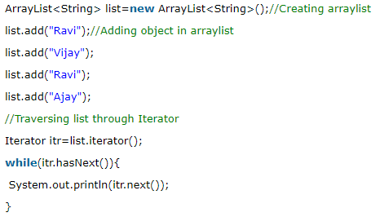

Slide 27
Iterator
Used to cycle through the elements in a collection.
For example: to display each element.
Iterator enables us to cycle through a collection, obtaining or removing elements.
Iterator is a generic interfaces which are declared as shown here:
interface Iterator<E>
Here, E specifies the type of objects being iterated.

Slide 28
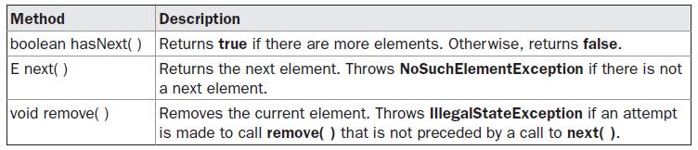
Iterator
Iterator<String> it = al.iterator();

Slide 29
Iterators and Loops
Iterator<String> iterator = al.iterator();
Iterators are often used in while and “for-each” loops
  hasNext returns true if there is a next element
  next returns a reference to the value of the next element
  Note : in for each loop iterator is used ‘behind the scenes’
while (iterator.hasNext())
{
String name = iterator.next();
// Do something with name
}
for (String name : employeeNames)
{
// Do something with name
}

Slide 30
To increase the capacity of an ArrayList object manually.
We might want to do this if we know in advance that we will be storing many more items in the collection than it can currently hold.
By increasing its capacity once, at the start, we can prevent several reallocations later.
Because reallocations are costly in terms of time, preventing unnecessary ones improves performance.
The signature for ensureCapacity( ) is:
void ensureCapacity(int cap)
Here, cap is the new capacity.

Slide 31
If we want to reduce the size of the array that underlies an ArrayList object so that it is precisely as large as the number of items that it is currently holding by using trimToSize( ) method.
void trimToSize( )

Slide 32
Obtaining an Array from an ArrayList
to obtain an actual array that contains the contents of the list.
toArray( ) is defined by Collection.
Reasons to convert a collection into an array:
To obtain faster processing times for certain operations
To pass an array to a method that is not overloaded to accept a collection
To integrate collection-based code with legacy code that does not understand collections

Slide 33
ArrayList<Integer> al = new ArrayList<Integer>();
al.add(1);
al.add(2);
al.add(3);
al.add(4);
System.out.println("Contents of al: " + al);
// Get the array.
Integer ia[] = new Integer[al.size()];
ia = al.toArray(ia);
int sum = 0;
for(int i : ia)
sum += i;
System.out.println("Sum is: " + sum);

Slide 34
import java.util.*;
class Student
{
int regno;
String name;
Student(int a, String b)
{
regno = a;
name = b;
}
void disp()
{
System.out.println("Regno : "+regno+" name : "+name);
}
}

Slide 35
class ArrayListStud
{
public static void main(String args[])
{
ArrayList<Student> a = new ArrayList<Student>();
a.add(new Student(1,"anil"));
a.add(new Student(2,"sunil"));
a.add(new Student(3,"rahul"));
a.add(new Student(4,"sachin"));
a.add(new Student(5,"kiran"));
for(Student s : a)
s.disp();
}
}

Slide 36
Vector
Vector implements a dynamic array.
It is similar to ArrayList, but with two differences:
  Vector is synchronized, and
  it contains many legacy methods that are not part of the Collections

Slide 37
Vector
With the advent of collections, Vector was reengineered to extend AbstractList and to implement the List interface.
With the release of JDK 5, it was retrofitted for generics and reengineered to implement Iterable.
This means that Vector is fully compatible with collections, and a Vector can have its contents iterated by the enhanced for loop.

